Slide 1
Zero Trust
The Concept, Standards, Requirements, Timeline, Directions
Dennis Moreau,
Sr Engineering Architect, Cybersecurity
VMware, Research and Innovation, Office of the CTO
9/24/2021

Slide 2
What is Zero Trust and how does it work (to address supply chain security, ransomware and complexity)?
Where are the standards now?
NIST ZT Reference Architecture
DoD ZT Reference Architecture
NIST Guidance on ZT for Microservices and Service Mesh
NCCoE Collaboration on ZT
The ZT Timeline
Guidance
NIST NCCoE Audit Guidance
CISA Maturity Model
CISA Cloud security Reference Architecture
Timeline (EO-14028, CMMC, EU NIS2, …)
UK NCSC ZT Architecture Guidelines
EU NIS2 ZT (ENISA) – Parliament vote in November

Slide 3
ZT Assumption of Compromise == Supply Chain Attack.
Colonial Pipeline RW & Exfil Attack (DoubleDip)
5000 Mile Pipeline, 100s of Remote Valves, 200 M${ft}^{3}$, $5M Ransom, $$$ Business Impact…
5000 Mile Pipeline, 100s of Remote Valves, 200 M〖𝑓𝑡〗^3, $5M Ransom, $$$ Business Impact…
400,000 Pipeline mile potentially vulnerable. $$$$ Threat is orders of magnitude larger in just pipeline control, availability, safety
SunBurst (Solarigate) Supply Chain Attack
Undetected for 15 Months (despite 18K Security Portfolios & Teams)
CodeCov Supply Chain Attack
Any credentials, tokens, or keys passed to Continuous Integration runner
19,000 Customers including IBM, HP, Atlassian, Rapid 7 … who are also participants in supply chains… downstream damage still being investigated.
Injected into the DevOps cycle, Global Sourcing (Bulgaria), Inadequate curation/testing/isolation …
Any services, data stores, and application code that could be accessed with these credentials, tokens, or keys
$$$$$ Remediation – eDesign, Replacement , OpEx++, Reg, …
Triggering standards, regulatory and procurement response (see WH EO)

Slide 4
Long Undetected Compromises, a Prelude to Many Ransomware .
Supply Chain [1]
Attacks up by 42% in Q1 of 2021 – Data compromise only increased by 12%
Q1 SC Attacks: 27 Vendors, 140 Organizations publicly reported as targets, 7.4 M impacted
Number of affected individuals up by 560%
Trend is to compromise multiple organizations through one point of attack
Huge spike in insurance claims due to services outages (MS Exchange Attack 30,000-60,000 Orgs) – Legal, Forensic , Cleanup, Disruption and Fines
Increasingly Combined with Data Extortion (ransomware) [2]
228 Industrials and Engineering
225 Manufacturing
145 Technology
142 Retail
95 Healthcare
Pressure is on governments to “Do Something”!
Enter the EO for Improving National Cybersecurity, NIST, CISA, NSA and the DoD…
Sources (1) Crowdstrike 2021 Global Threat Report
(2) Identity Theft Resource Center 2021

Slide 5
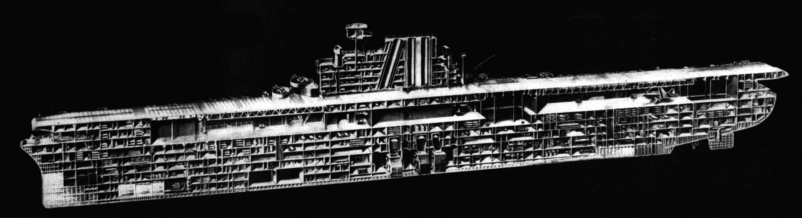
Zero Trust – is a very different policy approach …
Continuous, Granular, Policy Enforcement & Containment …
… via Compartmentalization (by application/service)
Notes:
Compartmentalization prevents damage in one area from sinking the entire ship.
Distribution allows key functions to continue to operate despite damage to one of its installations.
In the data center, this analogy must be extended to accommodate the fact that:
- the compartments must have dynamic boundaries (e.g. scale-out, load balance, failover, vmotion, …)
- new key services/applications emerge over time , so the number of compartments will also be dynamic

Slide 6
ZT Requires that we Assume Compromise … soooo
ZT Assumes compromise in supply chain and in the perimeter … so, compartmentalization is necessary.

Slide 7
But complete compartmentalization is not very useful …soooo
ZT Applies Compartment-specific policy, continuously.
Least Privilege + Require knowing all “subjects”
Least Functionality + Requires knowing all “objects”
Least Accessibility (crypt) + Requires knowing access needs
Least Exposure (posture) + Requires assessing device, service, platform integrity … dev due car, curation, testing
Coherence (peer, temporal) Requires knowing intended, expected and observed behavior
…
PEP

Slide 8
ZT Implies Many Continuous Enforcement Points … and Their Alerts
ZT Require Classification by Association to Business Impact : Risk = Prob * Impact
Business Risk
Categorized Function
Categorized Service
…
PEP
Comp Criticality <=
Categorized Comp
PEP
PEP
PEP
PEP
PEP
…
…
PEP
PEP

Slide 9
ZT Concept Space
ZT Policy
:= (Subjects, Objects, Risk)
Business Risk
Categorized Function
App Trust Anchor
Categorized Service
…
R
User Trust Anchor
PEP
Comp Criticality <=
Categorized Comp
ZT Ref Arch
Decoupling Bus Policy from Technology
R
Categorized Data
Platform Trust Anchor
ZT Capable Platform (Policy Enablement)
Topology, Isolation, Enforcement

Slide 10
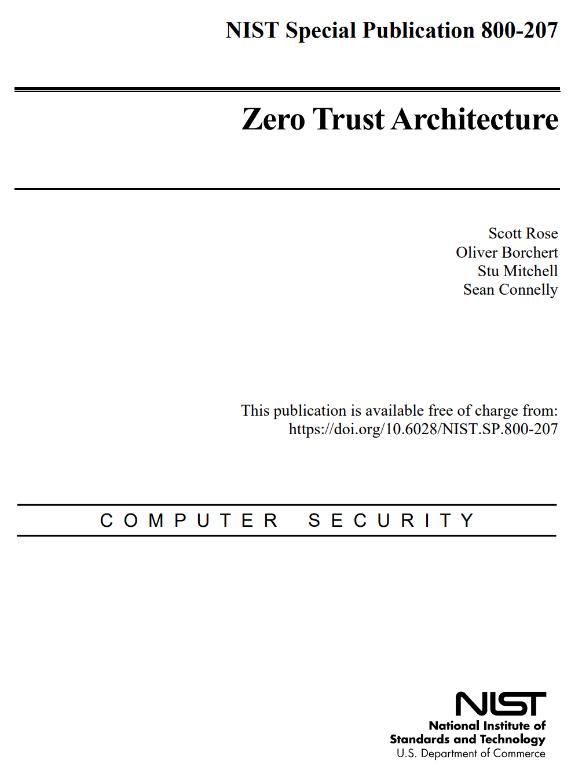
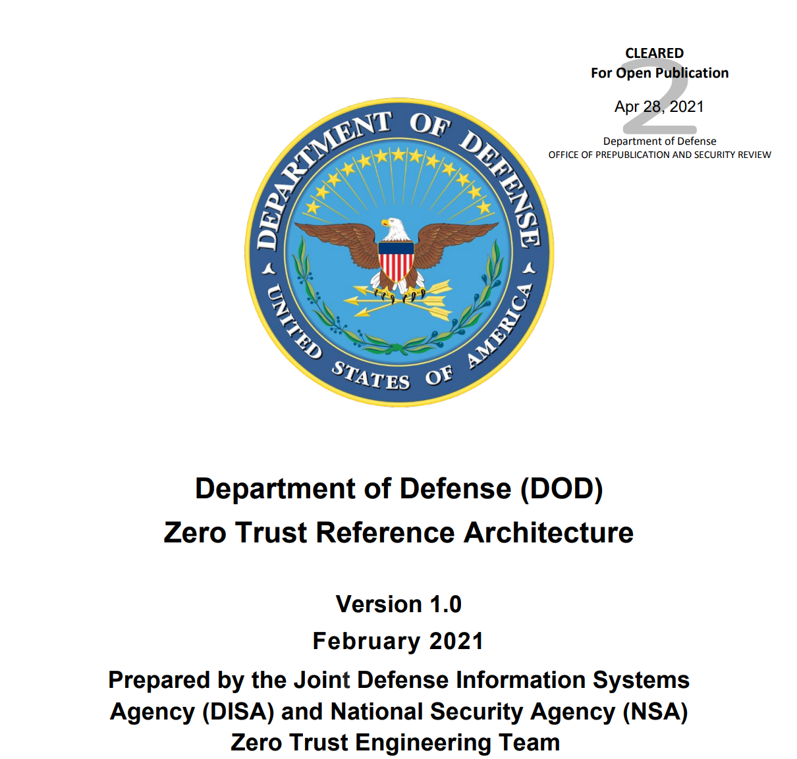
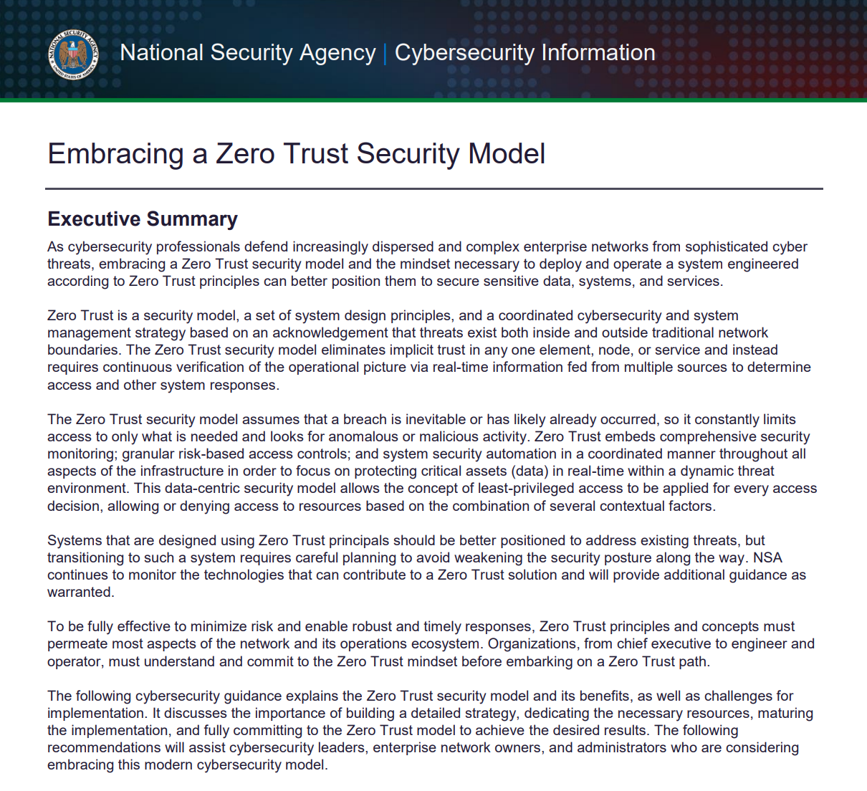
ZT as of Q2 2021 – The Definitions that Matter
DISA and NSA, Department of Defense (DOD) Zero Trust Reference Architecture Version 1.0
NIST, SP 800-207, Zero Trust Architecture
NSA, Embracing a Zero Trust Security Model

Slide 11
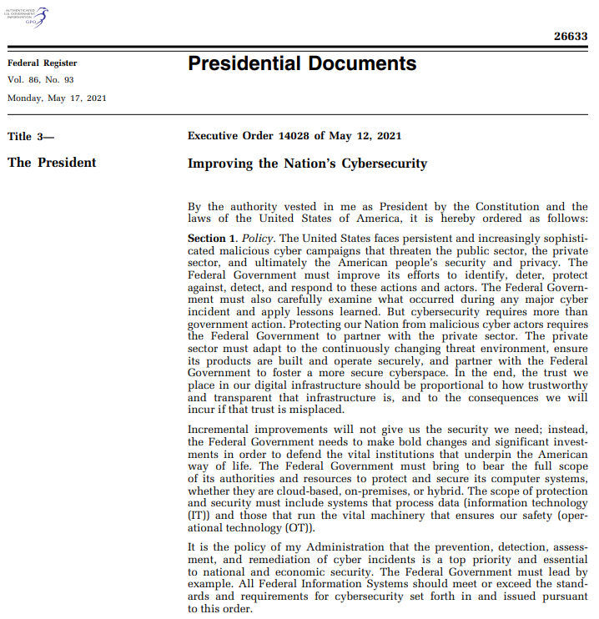
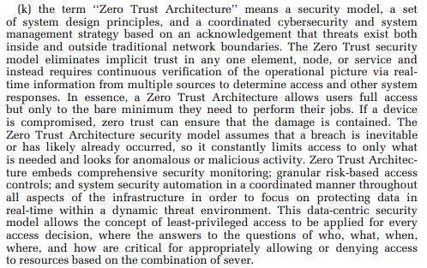
Zero Trust – Why it matters? - The Mandate
https://www.federalregister.gov/documents/2021/05/17/2021-10460/improving-the-nations-cybersecurity#:~:text=Executive%20Order%2014028%20of%20May%2012%2C%202021%20Improving,it%20is%20hereby%20ordered%20as%20follows%3A%20Section%201.

Slide 12
What is Zero Trust?

Slide 13
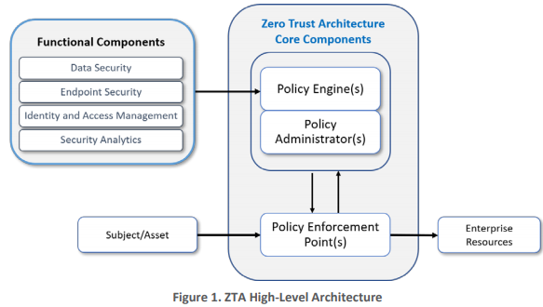
High-Level ZT Implementation Architecture
What does ZTA look like … by definition.
ZT Architecture
Required ZT Solution Telemetry
- Aligned on same Subject, Object and associated Transactional (Business; Not CVSS Risk)
ZT Policy Statements
(e.g. OPA, …)
Subjects (Page 7)
Users, Roles
Service Accounts
Identity Records (Rep)
…
Assets (Page 8)
Servers, Desktops (Page7)
Laptops, Tablets, Phones
Mobile & IoT Devices
Continuous Inline ZT Enforcement
Logically Adjacent to Resources (Objects)
Authoritative Controls and Independent Verification
Resources
Applications
Services
Micro-services/Containers (NSA)
(on Prem, Hosted, Cloud and Edge)

Slide 14
ZTA Implies Layering (end to end)
Risk Aware ZT Policy
e.g.: OPA + YAML + Stacklet
Enterprise Business aware ZT Policy
Criticality Impact aware – real Risk
Aligned from User To Enterprise Application
Entitlement and Anomaly Informed
e.g.: OPA + YAML + RiskMap
e.g.: OPA + YAML + Stacklet
(Subject, Object, Criticality/Importance)
User/Device/App
Session/Host/Hosted Service
ID/Container/Application-Micro-service, SM
Aligned ZT Conformant Policy (EU)
Aligned ZT Conformant Policy (GW)
Aligned ZT Conformant Policy (SM)
(Subject, Object, Criticality/Importance)
(Subject, Object, Criticality/Importance)
(Subject, Object, Criticality/Importance)

Slide 15
NSA Caveat on Partial ZTA Implementations (limited ZT protection)
When adding fractional ZT makes policy management less effective (NSA) Also see EO 10(k)
Enterprise Business aware ZT Policy
Criticality Impact aware – real Risk
Aligned from User To Enterprise Application
Entitlement and Anomaly Informed
Conventional Policy Structure
(Non-ZT)
User/Device/App
Session/Host/Hosted Service
ID/Container/Application-Micro-service
Non-ZT
Non-ZT
Typically mis-aligned User/Device/App - Session/Host/Hosted Service
Mis-configured Intention (guard rails – Config, Roles, Classification) and Observation (verification – EDR, ML)
Traditional scattered security architecture (Policy aligned on VPN, VLAN, Perimeter, …)
False sense of ZT
https://media.defense.gov/2021/Feb/25/2002588479/-1/-1/0/CSI_EMBRACING_ZT_SECURITY_MODEL_UOO115131-21.PDF

Slide 16
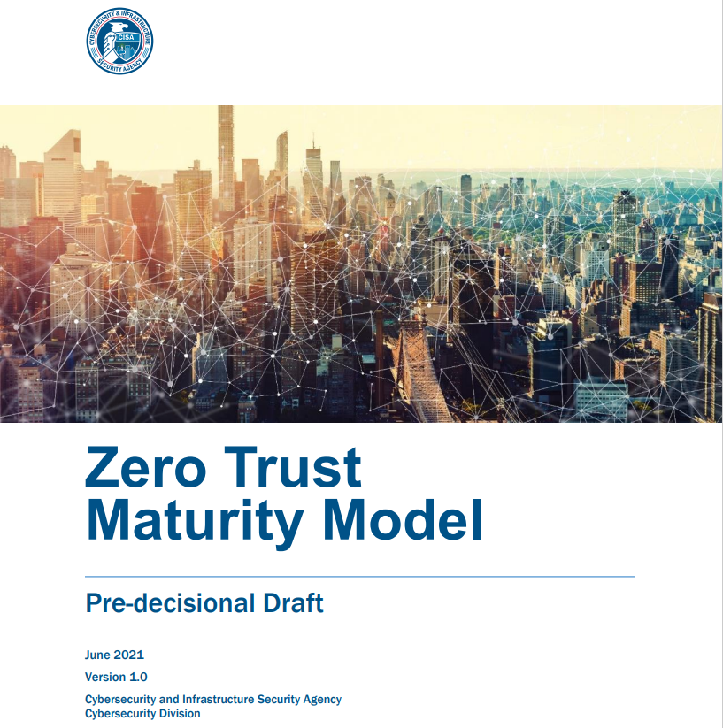
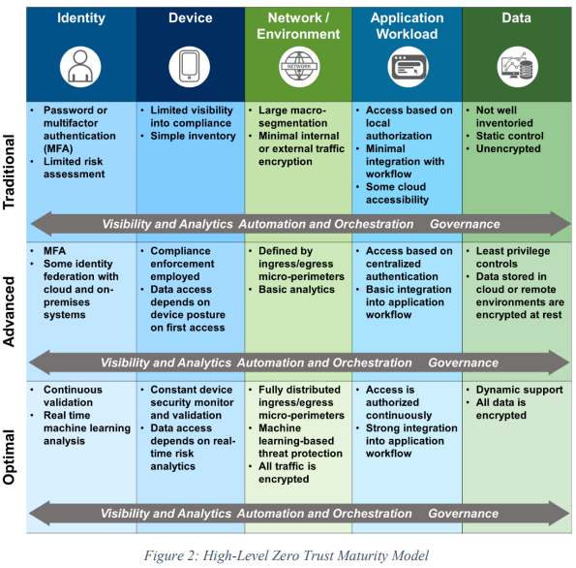
CISA ZT Maturity Model (DRAFT - PC Opened 9/2021)
https://www.cisa.gov/sites/default/files/publications/CISA%20Zero%20Trust%20Maturity%20Model_Draft.pdf

Slide 17
Important Observations from CISA ZT MM Document
[Page ii]
The path to zero trust is an incremental process that will take years to implement.
Legacy infrastructure and systems may not support a zero trust implementation.
[Page 2] Zero trust presents a shift from a location-centric model to a more data-centric approach for fine-grained security controls between users, systems, data and assets that change over time; for these reasons, moving to a ZTA is non-trivial. This provides the visibility needed to support the development, implementation, enforcement, and evolution of security policies. More fundamentally, zero trust may require a change in an organization’s philosophy and culture around cybersecurity. The path to zero trust is a journey that will take years to implement.
[Page 3] 6. Challenge The Federal Government faces several challenges in transitioning to ZTA. First, legacy systems rely on “implicit trust”; this concept conflicts with the core principle of adaptive evaluation of trust within a ZTA. Additionally, existing infrastructures are also built on implicit trust and must either be rebuilt or replaced. To rebuild or replace information technology (IT) infrastructure and mission systems requires a significant investment on the part of agencies. Lastly, there is no consensus on or formal adoption of a maturity model for ZTA. While proposals for maturity models have been put forth, current initiatives for kickstarting zero trust adoption are often focused on the network layer and do not present a holistic approach for transition

Slide 18
CISA MM Transitioning to ZT [Page 4]
https://www.cisa.gov/sites/default/files/publications/CISA%20Zero%20Trust%20Maturity%20Model_Draft.pdf
Transitioning to Zero Trust:
Identify Actors on the Enterprise.
Identify Assets Owned by the Enterprise.
Identify Key Processes and Evaluate Risks Associated with Executing Process.
The Basis for Business Impact (Risk)
Formulating Policies for the ZTA Candidate.
Identifying Candidate Solutions.
Initial Deployment and Monitoring

Slide 19
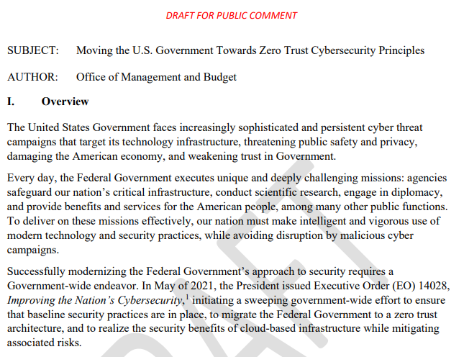
OMB Updates M-Series Memos
OMB owns policy and contract language.
Federal Zero Trust Strategy - Moving the U.S. Government Towards Zero Trust Cybersecurity Principles - https://zerotrust.cyber.gov/downloads/Office%20of%20Management%20and%20Budget%20-%20Federal%20Zero%20Trust%20Strategy%20-%20DRAFT%20For%20Public%20Comment%20-%202021-09-07.pdf

Slide 20
Where are we now?

Slide 21
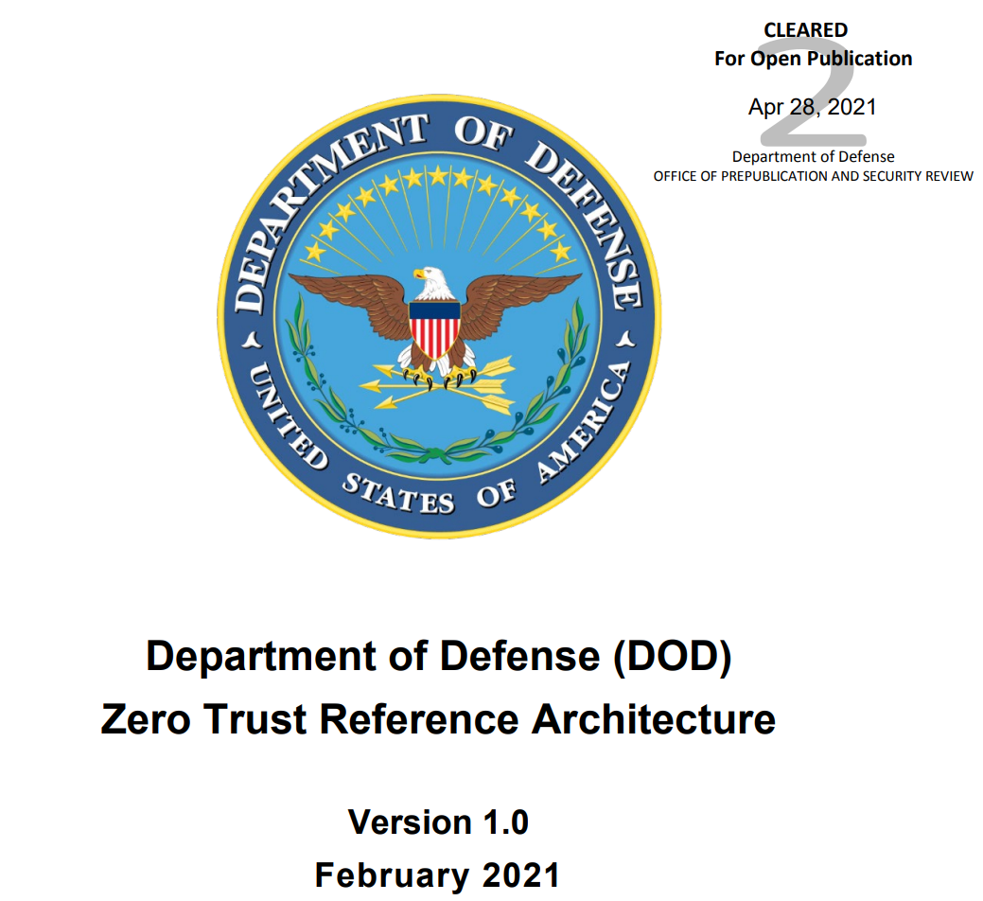
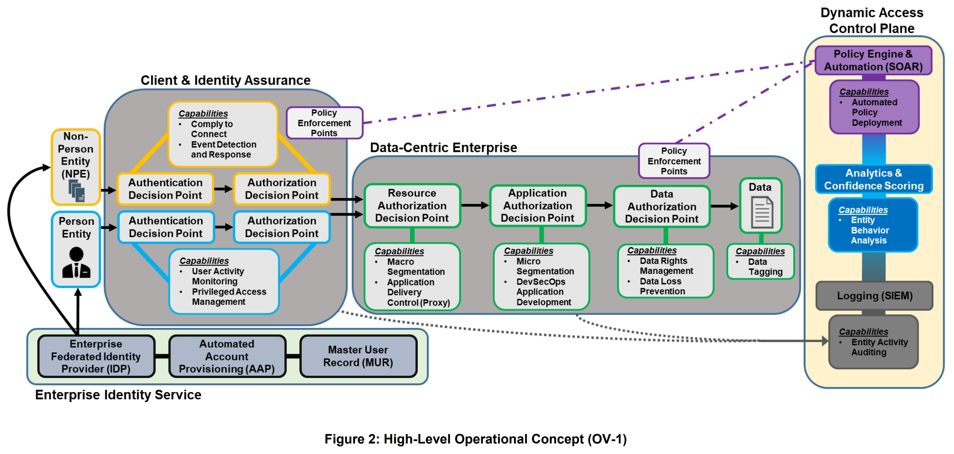
What does ZT look over existing technology
DoD ZT Reference Architecture: https://dodcio.defense.gov/Portals/0/Documents/Library/(U)ZT_RA_v1.1(U)_Mar21.pdf
CB
CB
CB

Slide 22
What does ZT look employing existing technology
DoD ZT Reference Architecture: https://dodcio.defense.gov/Portals/0/Documents/Library/(U)ZT_RA_v1.1(U)_Mar21.pdf
Device Posture
ZT Policy Expression
PEP Policy Deployment
Subjects, Objects
Continuous Risk Eval
Container Granularity Containment/Isolation
App Trust Anchor
Intentional Classification of Sensitivity
Object Trust Anchor
Subject Trust Anchor

Slide 23
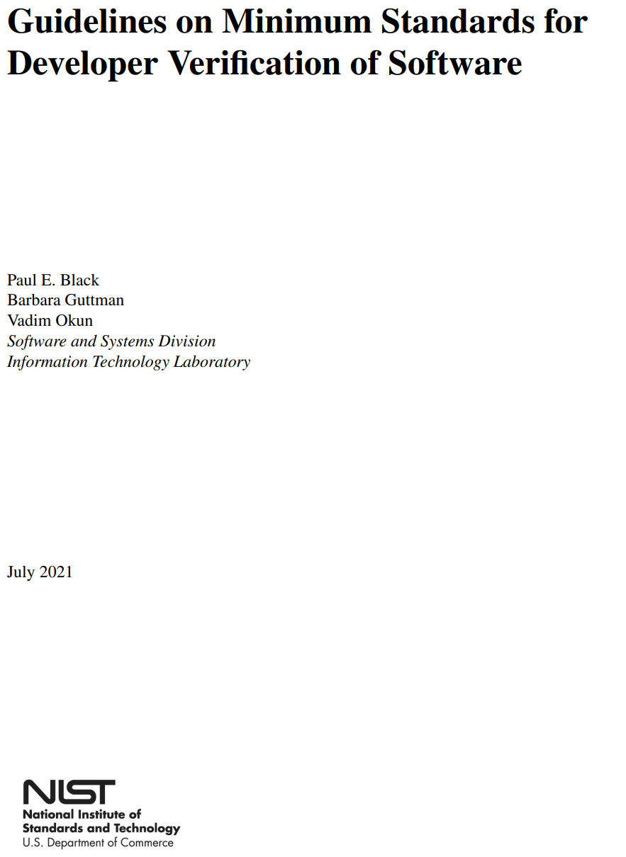
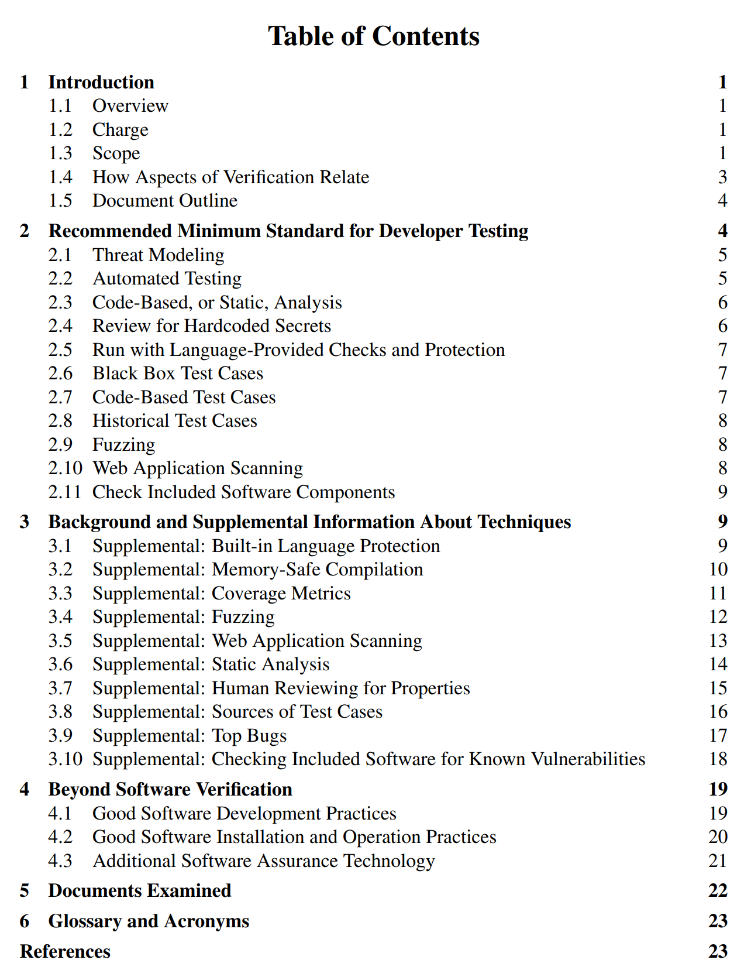
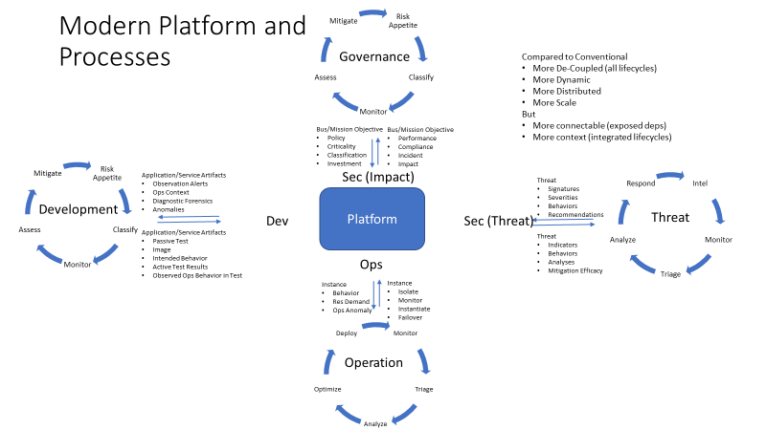
Application Trust Anchor based on “shifted left” security context
https://www.nist.gov/system/files/documents/2021/07/13/Developer%20Verification%20of%20Software.pdf

Slide 24
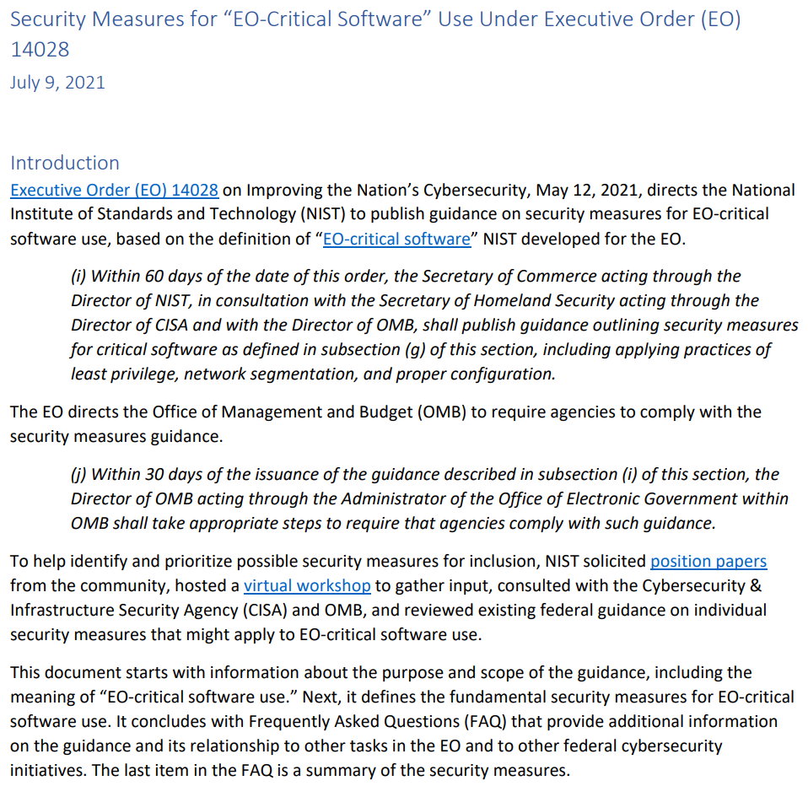
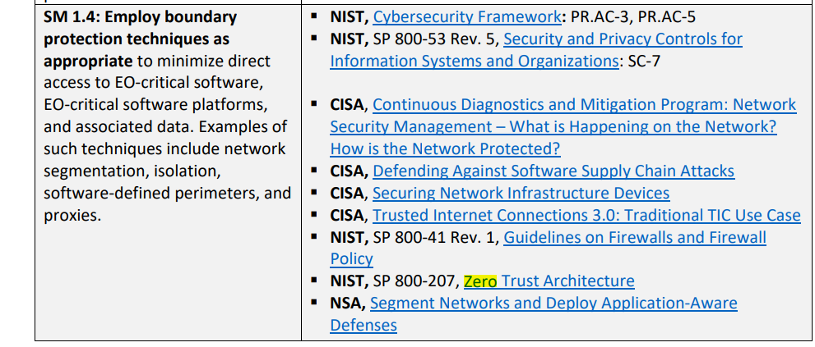
ZT Applies to Operation of “Critical Software”
… not just how you build secure stuff.
Zero Trust cited in 10 separate audit controls for the compliant and certifiable operation of “Critical Software”. ZT is not just a product capability for customers, it is also the kind of policy that is expected to constrain thecutomer’s operation of our platform.
https://www.nist.gov/system/files/documents/2021/07/09/Critical%20Software%20Use%20Security%20Measures%20Guidance.pdf

Slide 25
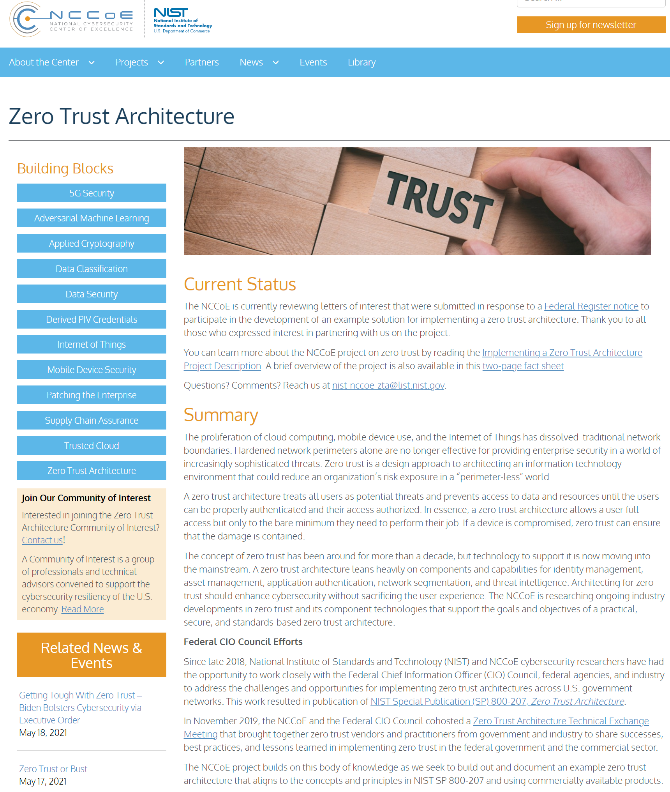
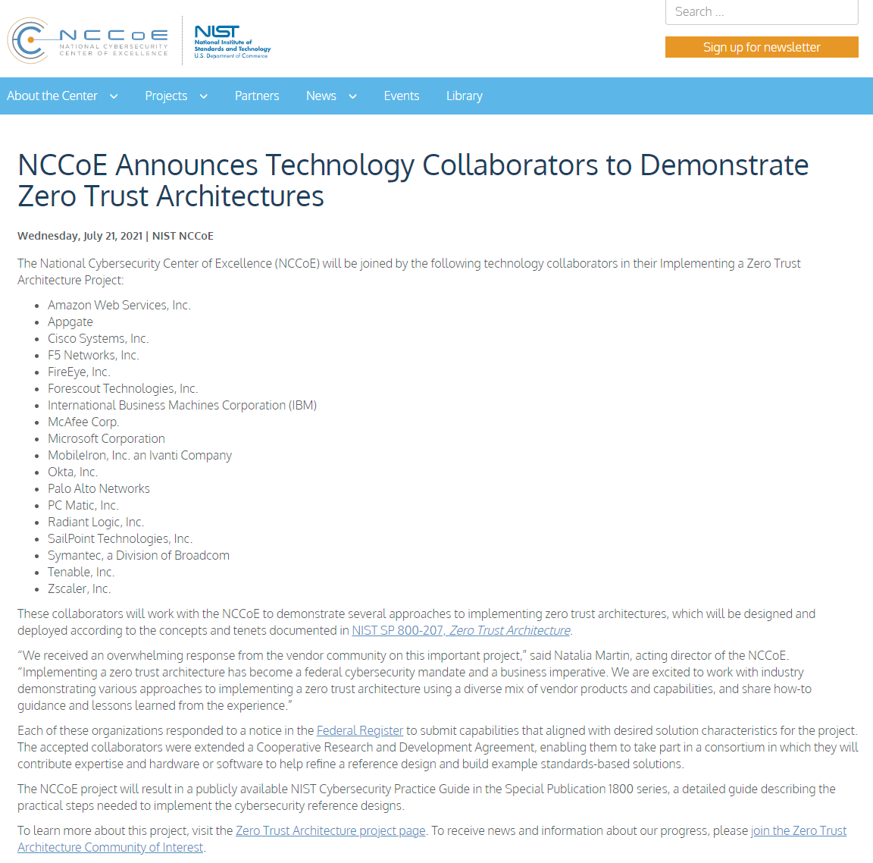
Enter NIST NCCoE
https://www.nccoe.nist.gov/projects/building-blocks/zero-trust-architecture

Slide 26
NCCoE Names 18 Firms for Zero Trust Collaboration Project | NCCoE (nist.gov)
NCCoE Names 18 Firms for Zero Trust Collaboration Project
Friday, July 23, 2021
The National Institute of Standards and Technology’s (NIST) National Cybersecurity Center of Excellence (NCCoE) has named 18 firms it will work with on NCCoE’s Implementing a Zero Trust Architecture Project.
The 18 companies – all of whom answered a public call for collaborators and entered a related cooperative research and development agreement with NCCoE – will work with the organization to demonstrate approaches to implementing zero trust architectures designed and deployed according the concepts and tenets in NIST’s Special Publication (SP) 800-207 on Zero Trust Architecture.
The goal of the project is to produce a publicly available NIST Cybersecurity Practice Guide that shows the practical steps to implement the cybersecurity reference designs.
Natalia Martin, NCCoE’s acting director, said the center received “an overwhelming response from the vendor community on this important project.”
“Implementing a zero trust architecture has become a Federal cybersecurity mandate and a business imperative,” she said. “We are excited to work with industry demonstrating various approaches to implementing a zero trust architecture using a diverse mix of vendor products and capabilities, and share how-to guidance and lessons learned from the experience.”
The 18 firms are: Amazon Web Services, Inc.; Appgate; Cisco Systems, Inc.; F5 Networks, Inc.; FireEye, Inc.; Forescout Technologies, Inc.; International Business Machines Corporation (IBM); McAfee Corp.; Microsoft Corporation; MobileIron, Inc. an Ivanti Company; Okta, Inc.; Palo Alto Networks; PC Matic, Inc.; Radiant Logic, Inc.; SailPoint Technologies, Inc.; Symantec, a Division of Broadcom; Tenable, Inc.; and Zscaler, Inc.
“Zero trust is a team sport and the NIST NCCoE is taking the initiative to bring together best-of-breed zero trust leaders,” commented Stephen Kovac, Vice President of Global Government and Head of Corporate Compliance at Zscaler.
“We are all committed to collaborating and demonstrating different, practical approaches to implement a zero trust architecture,” he said. “As we know, no one solution fits every situation. Zscaler is honored to be a part of this coalition working side by side to realize the opportunity for zero trust to strengthen every agency’s cyber defenses.”
“Cisco is happy to be a National Center of Excellence Partner (NCEP) of NCCoE since the beginning and are proud to continue contributing to their SP 1800 documents,” said Peter Romness, Cybersecurity Principal, U.S. Public Sector CTO Office, at Cisco. “These publications are used by governments and businesses around the world has guides to implement their own cybersecurity capabilities.”
“Zero Trust is a hot topic and our customers are looking for guidance from an impartial, trusted source like NIST,” he said. “Their SP 800-207 – Zero Trust Architecture, is already being used to understand zero trust. This new project will show examples of how to implement zero trust. We’re thrilled we were selected to help.”

Slide 27
NCCoE Evaluation Comparative Scenarios (Pages 5-6)
May be phased due to market balkanization of policy across segments and telemetries.
Scenario 1: Employee Access to Corporate Resources An employee is looking for easy and secure access to corporate resources, from any work location.
Scenario 2: Employee Access to Internet Resources An employee is trying to access the public internet to accomplish some tasks.
Scenario 3: Contractor Access to Corporate and Internet Resources A contractor is trying to access certain corporate resources and the internet.
Scenario 4: Inter-server Communication Within the Enterprise Corporate services often have different servers communicating with each other. For example, a web server communicates with an application server.
Scenario 5: Cross-Enterprise Collaboration with Business Partners Two enterprises In this scenario, the ZTA solution implemented in this project will enable users from one enterprise to securely access specific resources from the other enterprise, and vice versa.
Scenario 6: Develop Trust Score/Confidence Level with Corporate Resources. . In this scenario, a ZTA solution will integrate these monitoring and SIEM systems with the policy engine to produce more precise calculation of trust scores/confidence levels in near real time.
https://www.nccoe.nist.gov/sites/default/files/library/project-descriptions/zta-project-description-final.pdf

Slide 28
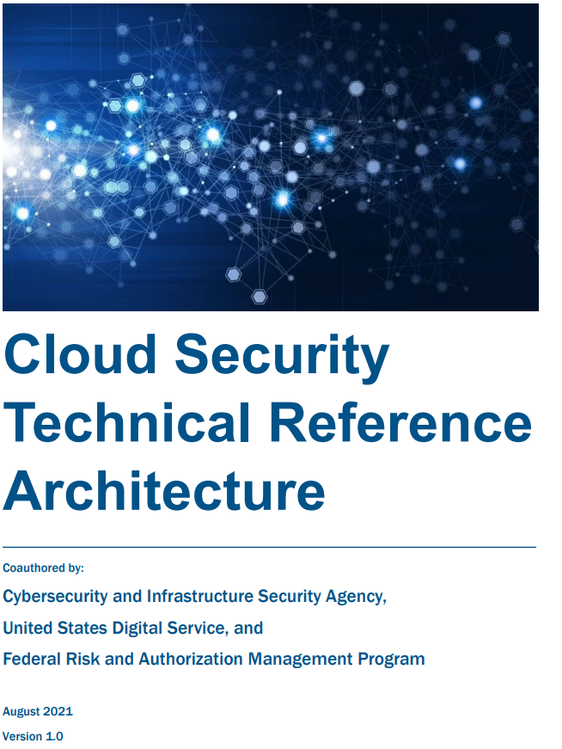
CISA Cloud Security Ref Arch (DRAFT - PC Opened 9/2021)
https://www.cisa.gov/sites/default/files/publications/CISA%20Cloud%20Security%20Technical%20Reference%20Architecture_Version%201.pdf
CISA CSRA Refers to Zero Trust 38 times:
“…
As agencies continue to use cloud technology, they shall do so in a coordinated, deliberate way
that allows the Federal Government to prevent, detect, assess, and remediate cyber incidents. To
facilitate this approach, the migration to cloud technology shall adopt zero trust architecture, as
practicable. The CISA shall modernize its current cybersecurity programs, services, and
capabilities to be fully functional with cloud-computing environments with zero trust
architecture. The Secretary of Homeland Security acting through the Director of CISA, in
consultation with the Administrator of General Services acting through the FedRAMP within the
General Services Administration, shall develop security principles governing Cloud Service
Providers (CSPs) for incorporation into agency modernization efforts. To facilitate this work:
[…]
Within 90 days of the date of this order, the Secretary of Homeland Security acting through the
Director of CISA, in consultation with the Director of OMB and the Administrator of General
Services acting through FedRAMP, shall develop and issue, for the Federal Civilian Executive
Branch (FCEB), cloud-security technical reference architecture documentation that
illustrates recommended approaches to cloud migration and data protection for agency
data collection and reporting.
…”

Slide 29
ZT Leverages DevSecOps The Platform Role: Zero Trust + Supply Chain + Dev…
Risk Appetite
Classify
Monitor
Assess
Mitigate
CJA
RiskMap
STIX
Governance
CyBOX
D3FEND
Risk Assessment:
e.g. OSCAL, CRMF
SCAPv2
InSPEC
Policy:
e.g. NIST Zero Trust
SP 800-207
SCAPv2
Bus/Mission Objective
Policy
Criticality
Classification
Investment
Bus/Mission Objective
Performance
Compliance
Incident
Impact
ATT&CK
Risk Appetite
Classify
Monitor
Assess
Mitigate
SP 800-161
NIST SP 800-171 CUI, NIST SP 800-172 CUI Enh.
Application/Service Artifacts
Observation Alerts
Ops Context
Diagnostic Forensics
Anomalies
Platform ID, Dep, Meta
Threat
Signatures
Severities
Behaviors
Recommendations
Intel
Monitor
Triage
Analyze
Respond
Platform
Development
Threat
Platform ID, Dep, Meta
Platform ID, Dep, Meta
Application/Service Artifacts
Passive Test
Image
Intended Behavior
Active Test Results
Observed Ops Behavior in Test
SWID
Threat
Indicators
Behaviors
Analyses
Mitigation Efficacy
Platform ID, Dep, Meta
Instance
SWID
Behavior
Res Demand
Ops Anomaly
Instance
Isolate
Monitor
Instantiate, Ref Arch
Failover, Scale, Recover
NIST SP 800-171A, NIST SP 800-172A CUI Enh.
OpenAPI
InSPEC
Logs:
LEEF
CIM
CADF
ARF
…
CI/CD Logs: SSDF
SP800-161A
STIX
SCAP/InSpec Inst Ref Arch: C4, DoDAF, SABSA, OpenDXL
Monitor
Triage
Analyze
Optimize
Deploy
SCAP/InSpec Assessment Tech Context
CyBOX
Operation
Kestrel
SCAPv2
InSPEC
STIX Shifter

Slide 30
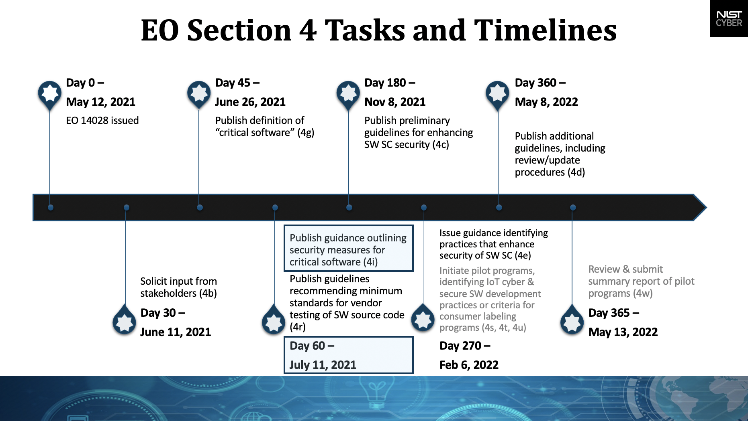
NIST and the EO 14028 (Where ZT is headed)
https://www.nist.gov/itl/executive-order-improving-nations-cybersecurity

Slide 31
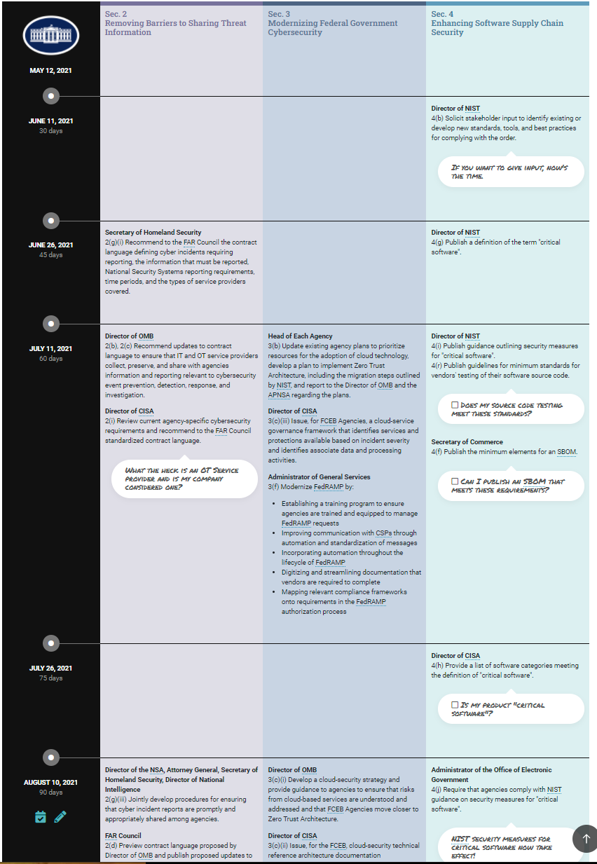
Scope + Timeline
EO-14028 Timeline (Adolus)
https://info.adolus.com/eo14028-timeline
Demostrates progressive refinement of requirements as they eminate from NIST, CISA, OMB, and FAR changes.

Slide 32

Zero Trust - UK
NSCS Zero Trust Architecture –
https://www.ncsc.gov.uk/collection/zero-trust-architecture
https://www.ncsc.gov.uk/section/ncsc-for-startups/overview
https://www.ncsc.gov.uk/blog-post/zero-trust-1-0
UK NCSC ZT Architecture Principles
Know your architecture, including users, devices, services and data.
Know your User, Service and Device identities.
Assess your user behaviour, device and service health.
Use policies to authorise requests.
Authenticate & Authorise everywhere.
Focus your monitoring on users, devices and services.
Don't trust any network, including your own.
Choose services designed for zero trust.

Slide 33
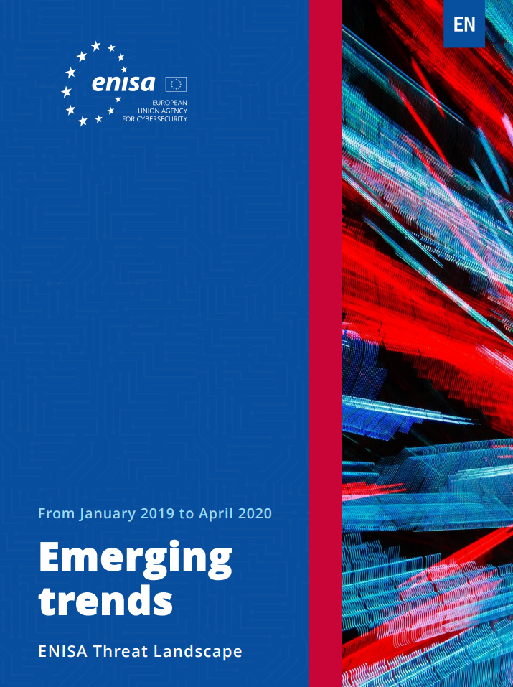
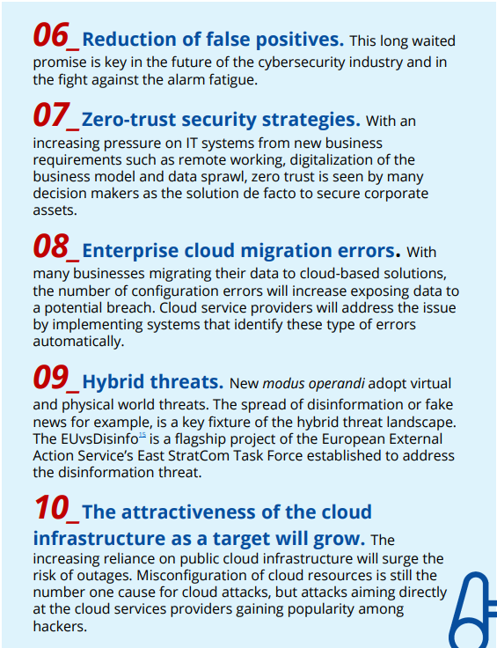
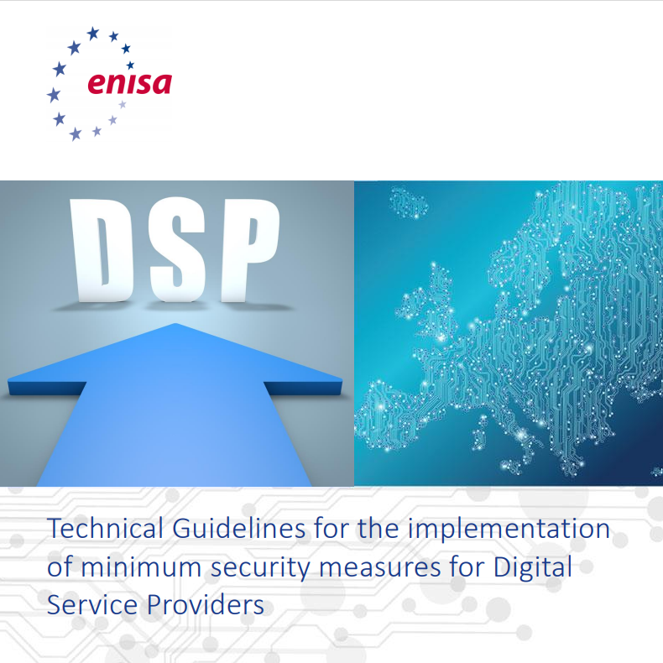
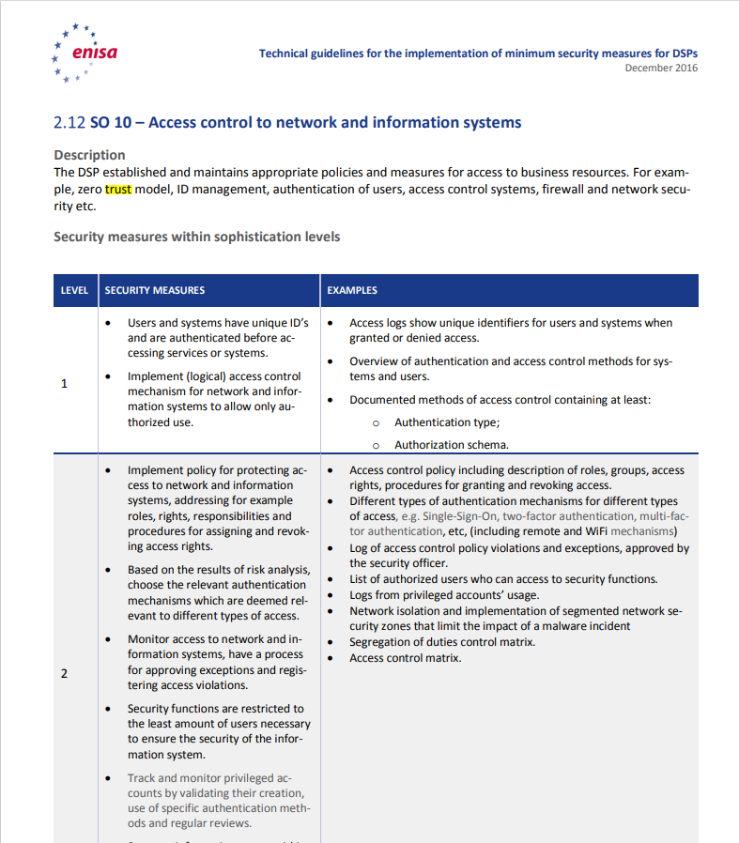
EU NIS2 and ZT – Parliament Vote now in November

Slide 34
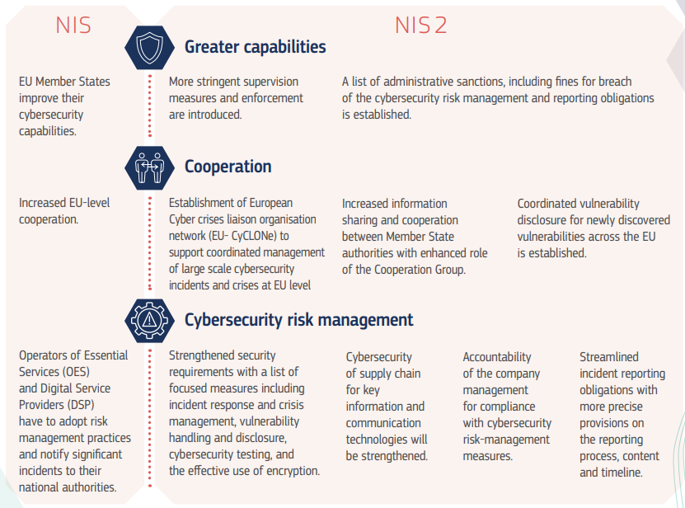
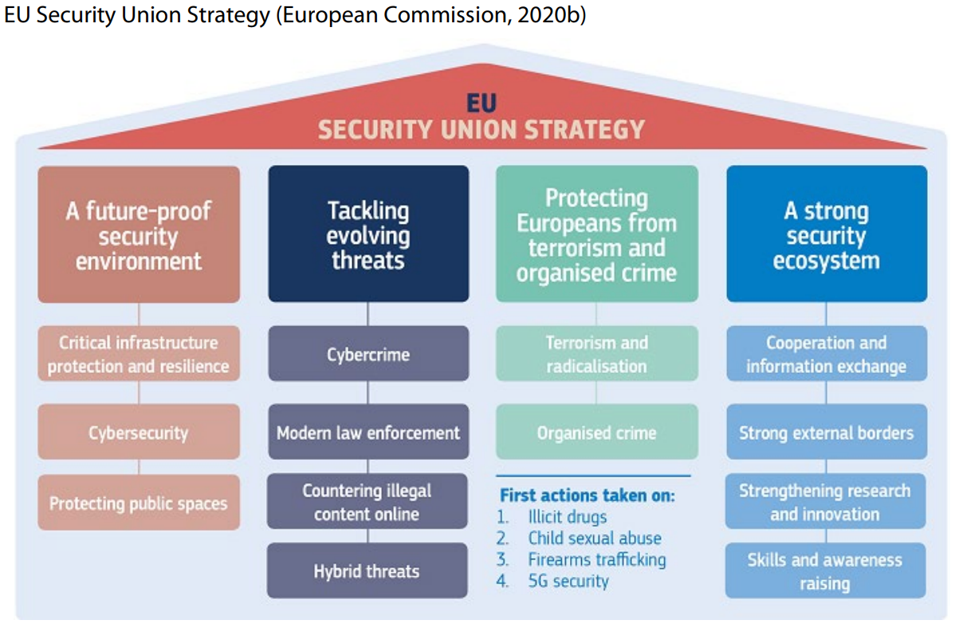
EU Supply Chain & DevSecOps & Incident/Vuln Reporting
Look Familiar??
https://www.europarl.europa.eu/RegData/etudes/BRIE/2021/689333/EPRS_BRI(2021)689333_EN.pdf
https://www.europarl.europa.eu/RegData/etudes/STUD/2021/653637/EXPO_STU(2021)653637_EN.pdf
Technical:
Enforcement of strong Authentication and Access Controls
Establishes CVE and related standards & coordination agreements to other CVE-based registries
Establishes top level DNS mandate
Zero Trust – Priority 7 - ENISA

Slide 35
ZT Guidance
NIST NCCoE ZTA Security Measures/Controls
CISA Maturity Model
CISA Cloud security Reference Architecture
NIST and the EO Timeline (pacing of additional ZT standards and guidance)

Slide 36
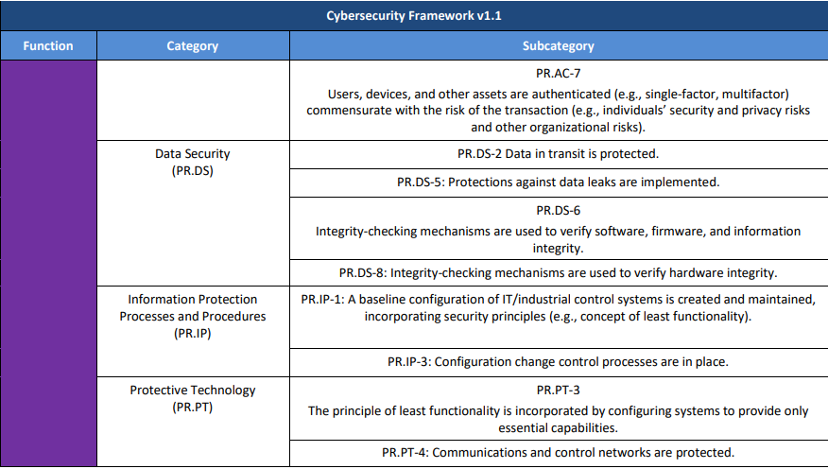
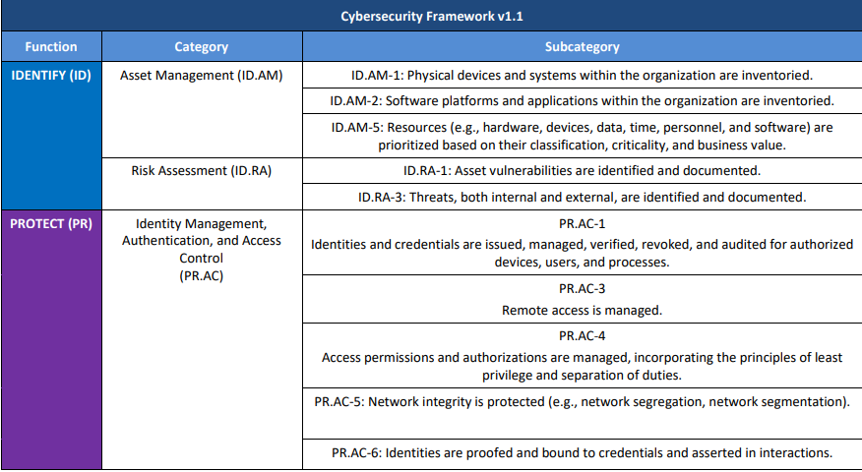
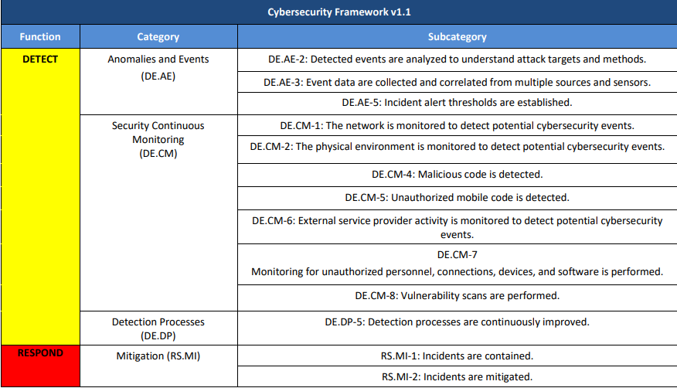
NCCoE ZTA Security Control Map. Comparison and Audit of ZTAs
What’s “Good Enough”? Pages 11-14
+SBOM
Multiple telemetry/sensor types collected and correlated (separation of Network, Endpoint, Service … telemetry/analytics is not the intent)
Known Payload Ident Required
LP + LF No single point of policy enforcement
Known Vuln Ident Required
https://www.nccoe.nist.gov/sites/default/files/library/project-descriptions/zta-project-description-final.pdf
Granular Isolation
NSA: Container level at least.`

Slide 37
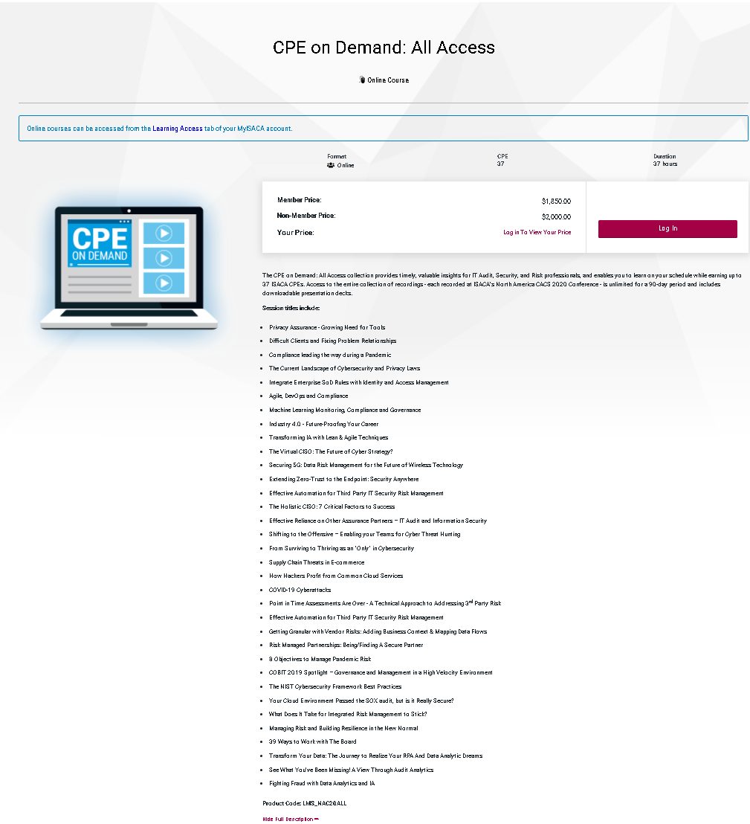
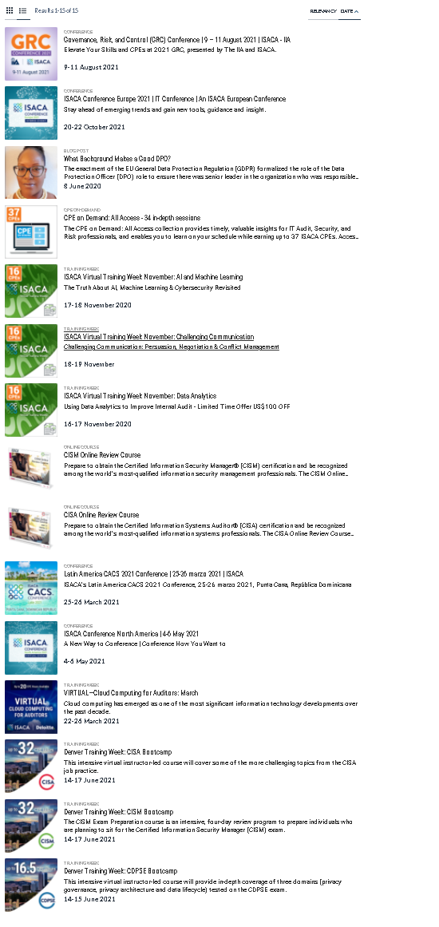
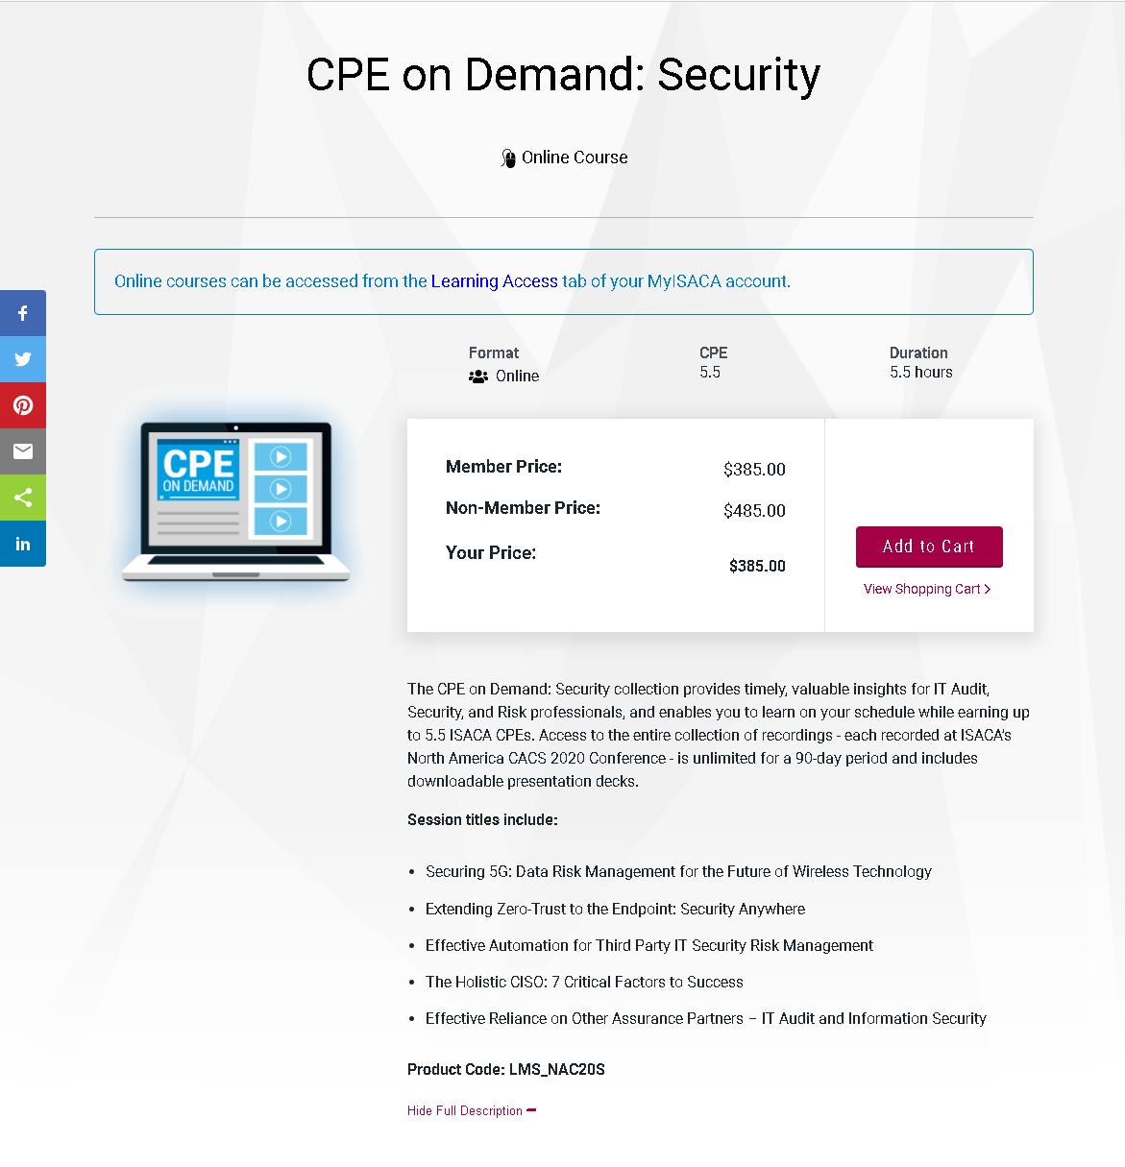
ZT Direction: ZT in Audit
200,000 Auditors : One ZT Definition

Slide 38
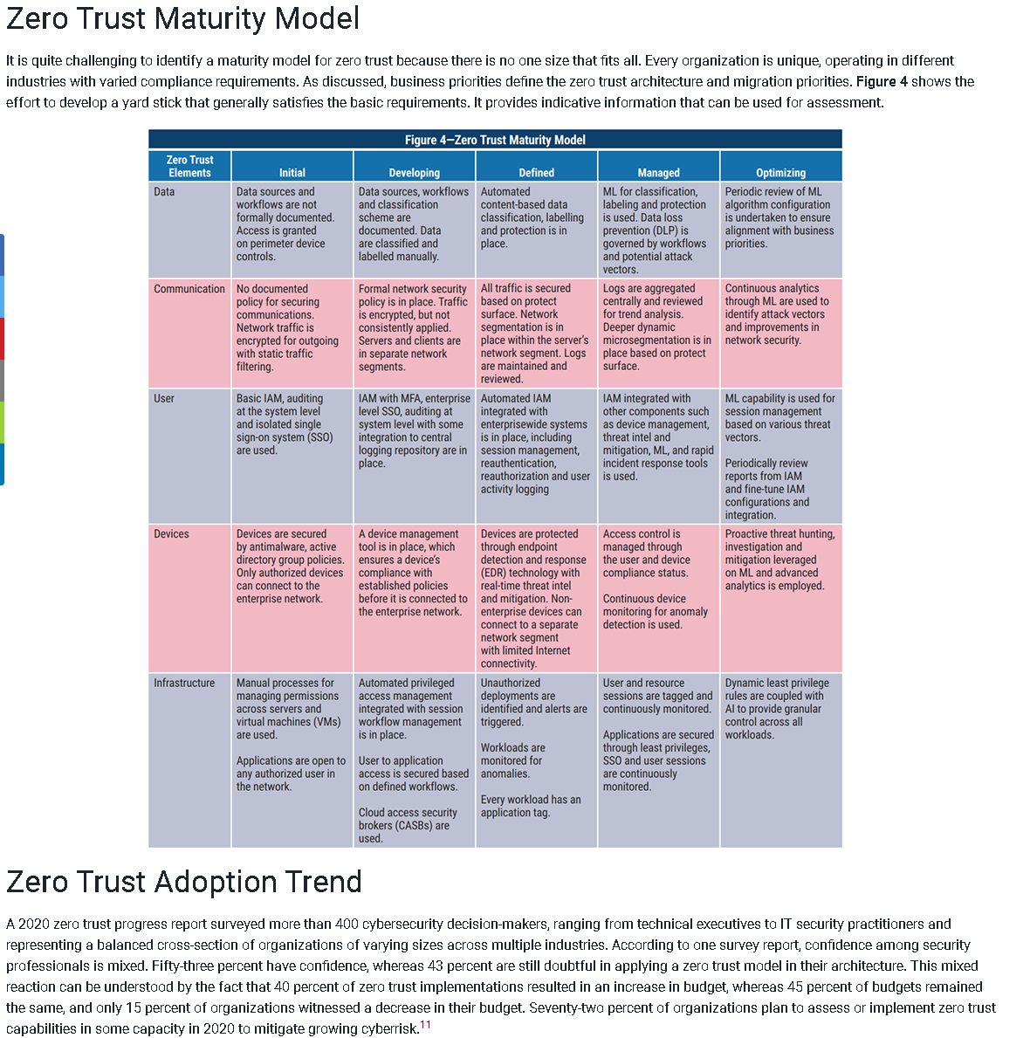
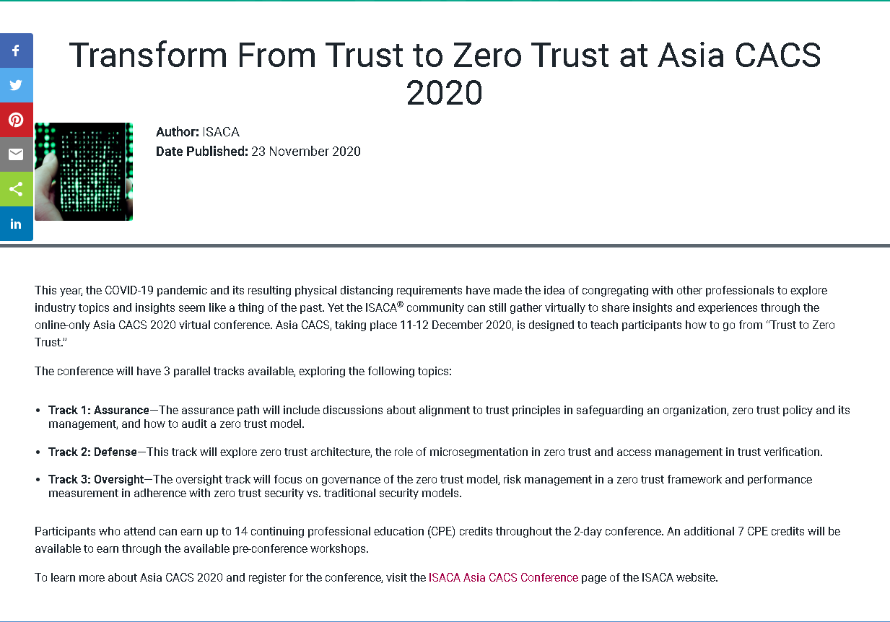
ZT Audit Prep - Global
CACS Global Auditor Guidance

Slide 39
CISA Cloud Security Ref Arch (DRAFT - PC Opened 9/2021)
https://www.cisa.gov/sites/default/files/publications/CISA%20Cloud%20Security%20Technical%20Reference%20Architecture_Version%201.pdf
CISA CSRA Refers to Zero Trust 38 times:
“…
As agencies continue to use cloud technology, they shall do so in a coordinated, deliberate way
that allows the Federal Government to prevent, detect, assess, and remediate cyber incidents. To
facilitate this approach, the migration to cloud technology shall adopt zero trust architecture, as
practicable. The CISA shall modernize its current cybersecurity programs, services, and
capabilities to be fully functional with cloud-computing environments with zero trust
architecture. The Secretary of Homeland Security acting through the Director of CISA, in
consultation with the Administrator of General Services acting through the FedRAMP within the
General Services Administration, shall develop security principles governing Cloud Service
Providers (CSPs) for incorporation into agency modernization efforts. To facilitate this work:
[…]
Within 90 days of the date of this order, the Secretary of Homeland Security acting through the
Director of CISA, in consultation with the Director of OMB and the Administrator of General
Services acting through FedRAMP, shall develop and issue, for the Federal Civilian Executive
Branch (FCEB), cloud-security technical reference architecture documentation that
illustrates recommended approaches to cloud migration and data protection for agency
data collection and reporting.
…”

Slide 40
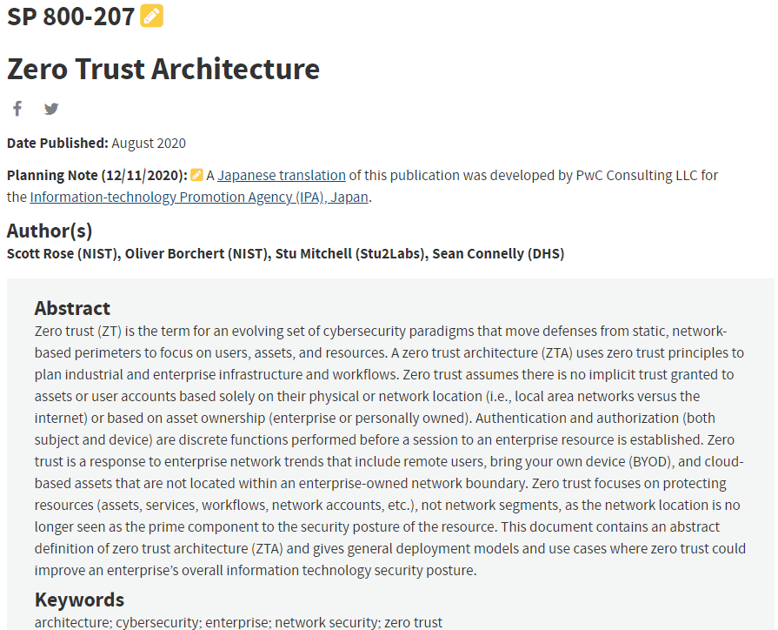
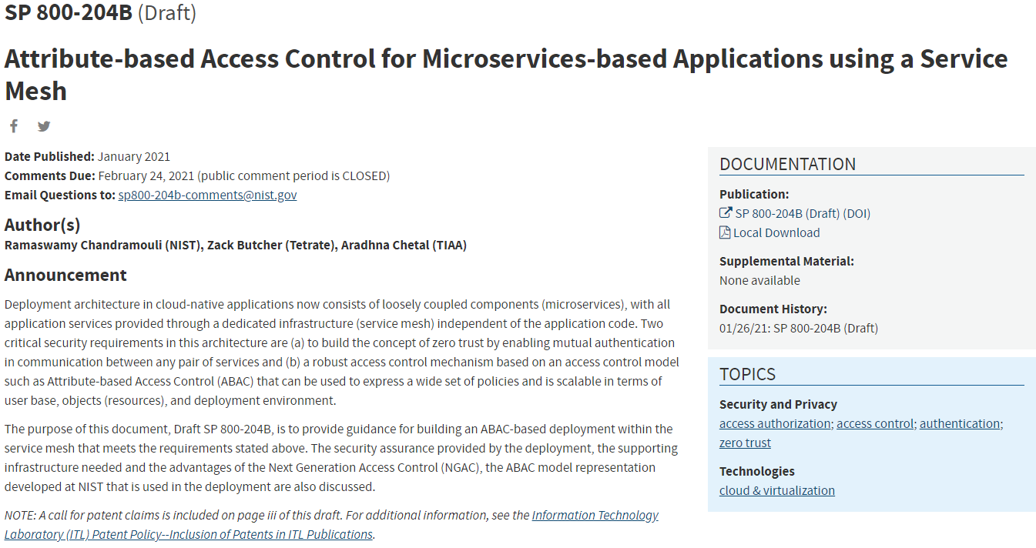
Zero Trust Extension
Implementing Zero Trust
Zero Trust – driving out implicit trust and reducing policy misconfiguration
Assume compromise of … endpoint, host, supply chain, app, account, integrity -> continuous independent verification on granular isolation
Establish the identity all subjects and continuously verify
Assure confidentiality, Integrity, Availability of all objects and continuously verify
Classify all interactions according to business risk
ZT Reference Architectures Enable
logical colocation of intentional and observational controls
On boundaries logically close to subject to be protected and subjects to be controlled
https://nvlpubs.nist.gov/nistpubs/SpecialPublications/NIST.SP.800-207.pdf
https://www.nccoe.nist.gov/sites/default/files/library/project-descriptions/zta-project-description-final.pdf
ZT Multi-Cloud: https://www.nist.gov/news-events/events/2021/01/devsecops-and-zero-trust-architecture-zta-multi-cloud-environments
ZT Service Mesh: https://csrc.nist.gov/publications/detail/sp/800-204b/draft

Slide 41
Recap
What is Zero Trust and how does it work (to address supply chain security, ransomware and complexity)?
Where are the standards now?
NIST ZT Reference Architecture
DoD ZT Reference Architecture
NIST Guidance on ZT for Microservices and Service Mesh
NCCoE Collaboration on ZT
The ZT Timeline
Guidance
NIST NCCoE Audit Guidance
CISA Maturity Model
CISA Cloud security Reference Architecture
Timeline (EO-14028, CMMC, EU NIS2, …)
UK NCSC ZT Architecture Guidelines
EU NIS2 ZT (ENISA) – Parlement vote in November

Slide 42
Thank You
Feedback, Questions, Followups and Collaboration
dmoreau@vmware.com

Slide 43
Appendix of Relevant Sources for ZTA Technical Requirements
From NIST bibliography on ZTA
NIST Cybersecurity Framework v.1.1, Framework for Improving Critical Infrastructure
Cybersecurity
https://nvlpubs.nist.gov/nistpubs/CSWP/NIST.CSWP.04162018.pdf
• NIST SP 800-30 Revision 1, Guide for Conducting Risk Assessments
https://doi.org/10.6028/NIST.SP.800-30r1
• NIST SP 800-37 Revision 2, Risk Management Framework for Information Systems and
Organizations: A System Life Cycle Approach For Security and Privacy
https://nvlpubs.nist.gov/nistpubs/SpecialPublications/NIST.SP.800-37r2.pdf
• NIST SP 800-40 Revision 3, Guide to Enterprise Patch Management Technologies
https://nvlpubs.nist.gov/nistpubs/SpecialPublications/NIST.SP.800-40r3.pdf
• NIST SP 800-46 Revision 2, Guide to Enterprise Telework, Remote Access, and Bring Your
Own Device (BYOD) Security
https://nvlpubs.nist.gov/nistpubs/SpecialPublications/NIST.SP.800-46r2.pdf
• NIST SP 800-53 Revision 4, Security and Privacy Controls for Federal Information
Systems and Organizations
https://csrc.nist.gov/csrc/media/publications/sp/800-53/rev-4/archive/2013-04-30/documents/sp800-53-rev4-ipd.pdf
• NIST SP 800-57 Part 1 Revision 4, Recommendation for Key Management: Part 1: General
https://nvlpubs.nist.gov/nistpubs/SpecialPublications/NIST.SP.800-57pt1r4.pdf
• NIST SP 800-61 Revision 2, Computer Security Incident Handling Guide
http://nvlpubs.nist.gov/nistpubs/SpecialPublications/NIST.SP.800-61r2.pdf
• NIST SP 800-63 Revision 3, Digital Identity Guidelines
https://nvlpubs.nist.gov/nistpubs/SpecialPublications/NIST.SP.800-63-3.pdf
• NIST SP 800-92, Guide to Computer Security Log Management
http://nvlpubs.nist.gov/nistpubs/Legacy/SP/nistspecialpublication800-92.pdf
• NIST SP 800-114 Revision 1, User's Guide to Telework and Bring Your Own Device
(BYOD) Security
https://nvlpubs.nist.gov/nistpubs/SpecialPublications/NIST.SP.800-114r1.pdf
• NIST SP 800-122, Guide to Protecting the Confidentiality of Personally Identifiable
Information (PII)
https://nvlpubs.nist.gov/nistpubs/legacy/sp/nistspecialpublication800-122.pdf
• NIST SP 800-124 Revision 2 (Draft), Guidelines for Managing the Security of Mobile
Devices in the Enterprise
https://nvlpubs.nist.gov/nistpubs/SpecialPublications/NIST.SP.800-124r2-draft.pdf
• NIST SP 800-160 Vol. 2, Developing Cyber Resilient Systems: A Systems Security
Engineering Approach
https://csrc.nist.gov/publications/detail/sp/800-160/vol-2/final
• NIST SP 800-162, Guide to Attribute Based Access Control (ABAC) Definition and
Considerations
https://nvlpubs.nist.gov/nistpubs/specialpublications/NIST.sp.800-162.pdf
• NIST SP 800-175B, Guideline for Using Cryptographic Standards in the Federal
Government: Cryptographic Mechanisms
https://nvlpubs.nist.gov/nistpubs/SpecialPublications/NIST.SP.800-175b.pdf
• NIST SP 800-171 Revision 2, Protecting Controlled Unclassified Information in
Nonfederal Information Systems and Organizations
https://nvlpubs.nist.gov/nistpubs/SpecialPublications/NIST.SP.800-171r2.pdf
• NIST SP 800-205, Attribute Considerations for Access Control Systems
https://nvlpubs.nist.gov/nistpubs/SpecialPublications/NIST.SP.800-205.pdf
• NIST SP 800-207 (Second Draft), Zero Trust Architecture
https://nvlpubs.nist.gov/nistpubs/SpecialPublications/NIST.SP.800-207-draft2.pdf
• NIST SP 1800-3, Attribute Based Access Control
https://www.nccoe.nist.gov/sites/default/files/library/sp1800/abac-nist-sp1800-3-draft-v2.pdf
• Cloud Security Alliance, Software Defined Perimeter Working Group, SDP Specification
1.0
https://downloads.cloudsecurityalliance.org/initiatives/sdp/SDP_Specification_1.0.pdf
• ISO/IEC 27001, Information Technology–Security Techniques–Information Security
Management Systems
• American Council for Technology-Industry Advisory Council, Zero Trust Cybersecurity
Current Trends
https://www.actiac.org/system/files/ACTIAC%20Zero%20Trust%20Project%20Report%2004182019.pdf
• Federal Information Processing Standards 140-3, Security Requirements for
Cryptographic Modules
https://nvlpubs.nist.gov/nistpubs/FIPS/NIST.FIPS.140-3.pdf

